Slide 1
Grand Stem Challenge 2023 Website Developement
CLB WEB 1

Slide 2
Table of contents
01
02
03
04
05
Team and task division
HTML,CSS, and Javascript
06
Concept and Purpose
Library and Framework
07
Chanllenge Solving
Project’s Key Feature
08
Design Choices
Personal Development

Slide 3

01
Our Team
CLB WEB 1

Slide 4
Our Team
Yeoh Wan Qi
Role: Database
SUN YI NING
Role: Design
LIM XING YING
Role: HTML BUILD

Slide 5
02
Concept and Purpose
CLB WEB 1

Slide 6

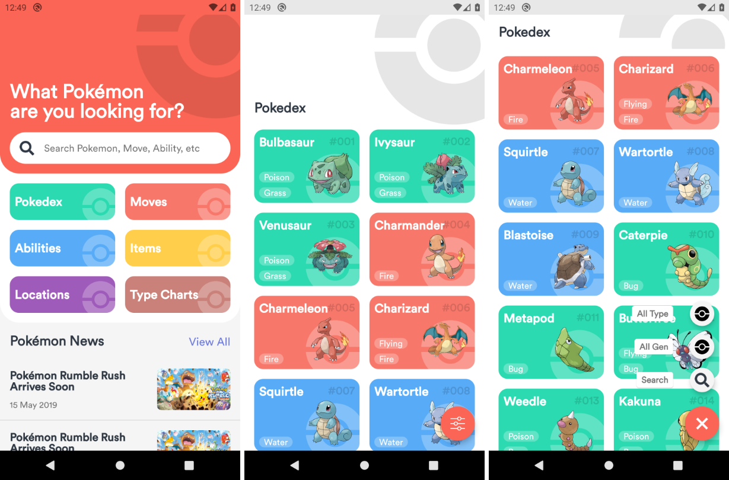
POKEDEX
To show Pokemon’s information

Slide 7
03
Project Key’s Feature
CLB WEB 1

Slide 9
04
Design Choices
CLB WEB 1

Slide 11
05
HTML,CSS and JAVASCRIPT
CLB WEB 1

Slide 13
06
Libraries and Framework
CLB WEB 1

Slide 14
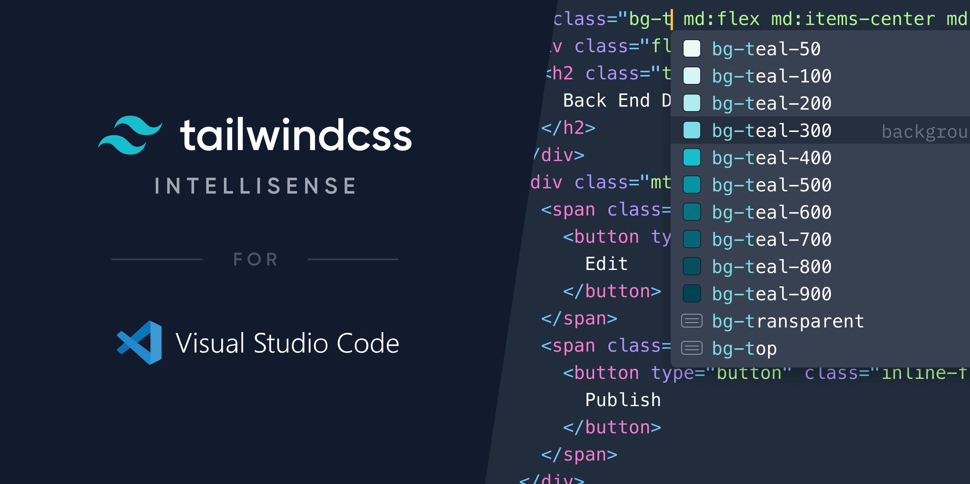
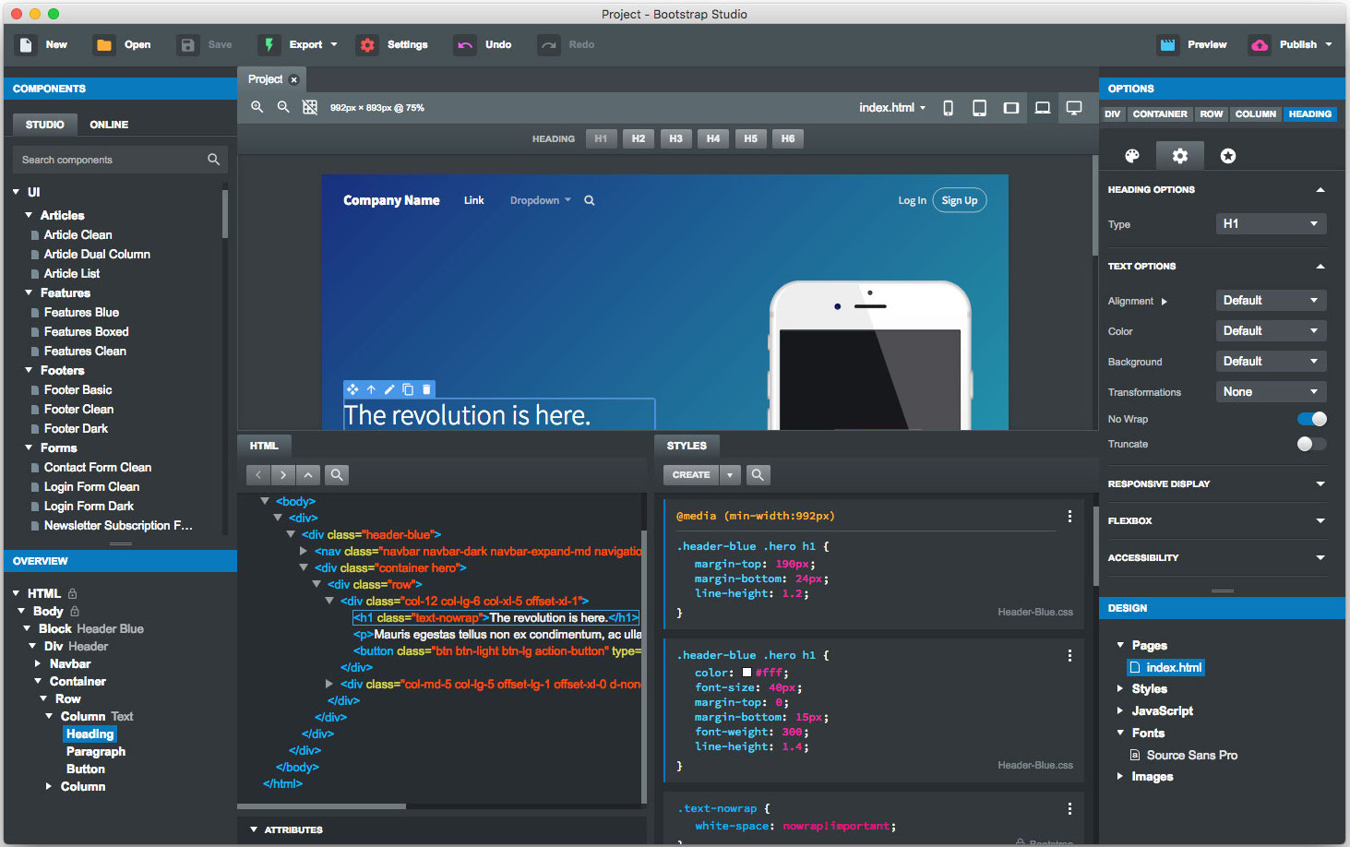
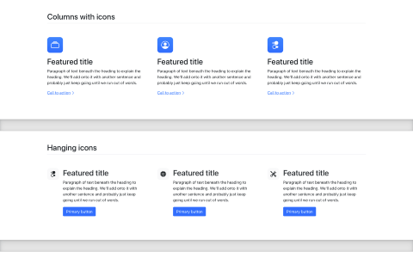
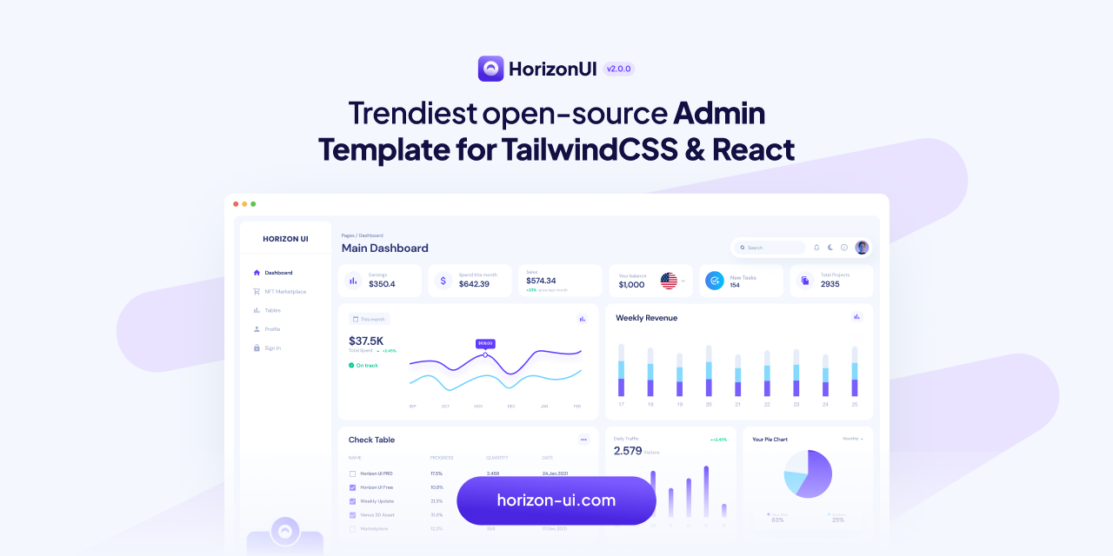
Libraries and Framework
TailwindCSS
Bootstrap

Slide 15
07
Challenge Solving
CLB WEB 1

Slide 16
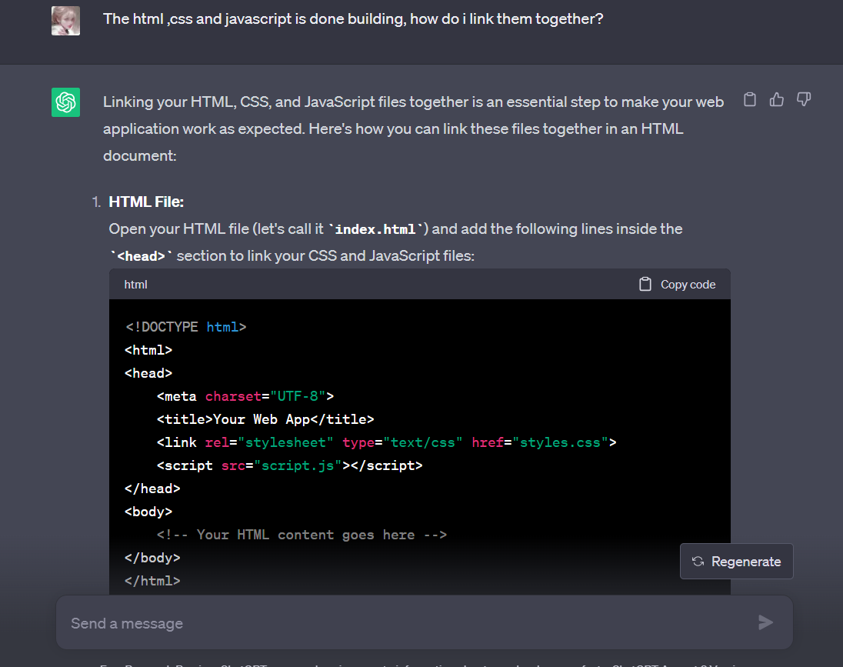
Error and Solving
Syntax Error
Unexisted File error
Minor Mistake of Spelling
Recheck
Ask Google
Seeking Help from Others
Use ChatGPT

Slide 17
08
Personal Development
CLB WEB 1

Slide 18
In this Chanllenge, we learn about…
Mars
Venus
Neptune
Despite being red, Mars is very cold
Venus is the second planet from the Sun
Neptune is the farthest planet from the Sun
Mercury
Saturn
Jupiter
Mercury is the closest planet to the Sun
Saturn is a gas giant and has several rings
Jupiter is the biggest planet of them all

Slide 19
Thanks for paying attention!
Present by: SUN YI NING, YEOH WAN QI, LIM XING YING
Please keep this slide for attribution

